Slide 1
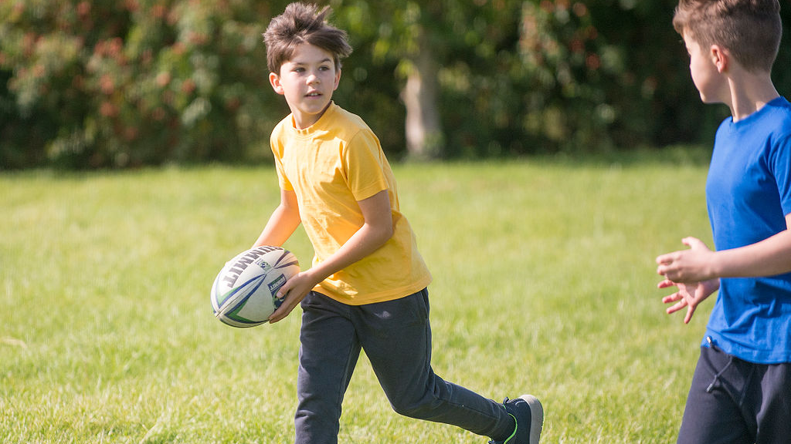
Pupil Voice
Physical Education at Heyhouses

Slide 2
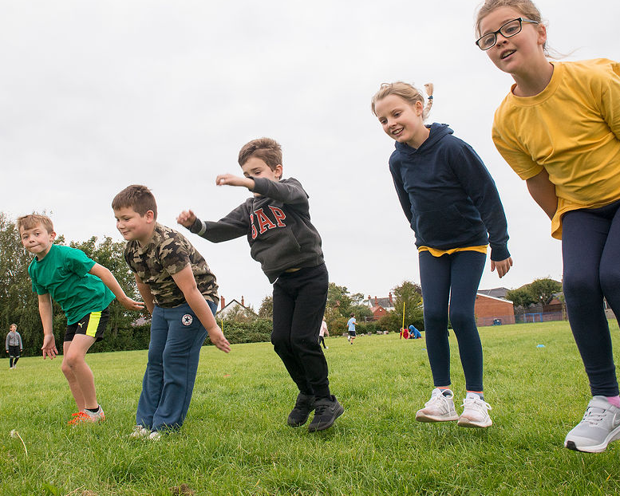
How would you describe PE lessons?

Slide 3
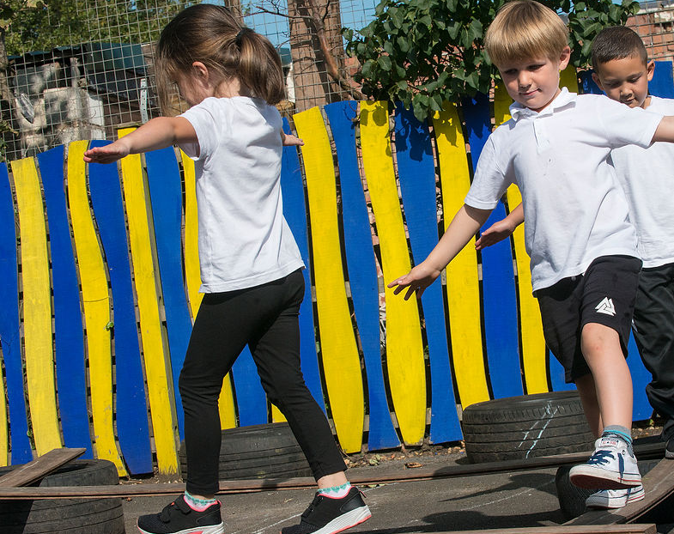
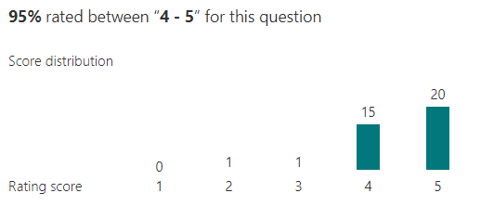
I would rate my PE lessons…

Slide 4
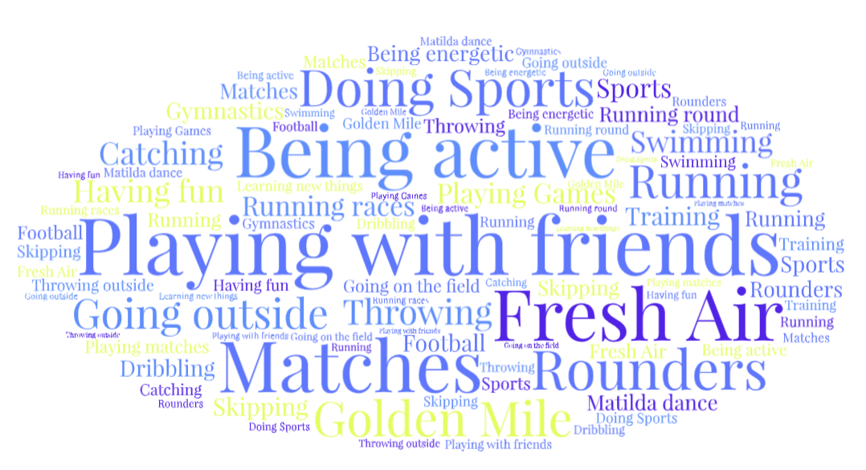
My favourite thing about my PE lesson is…

Slide 5
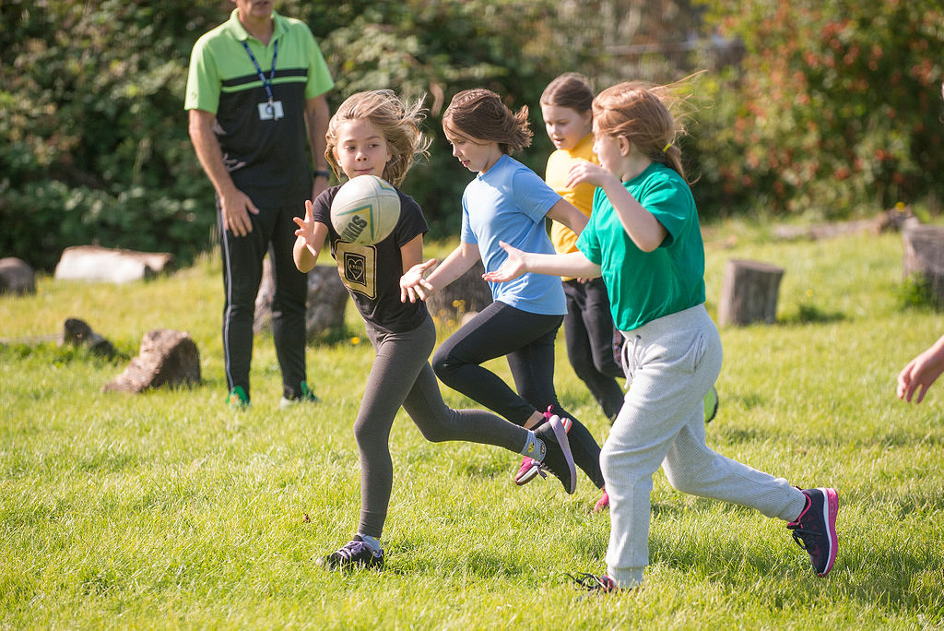
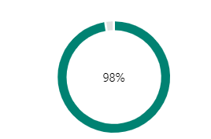
How many PE lessons do you have each week?
98% of children answered two

Slide 6
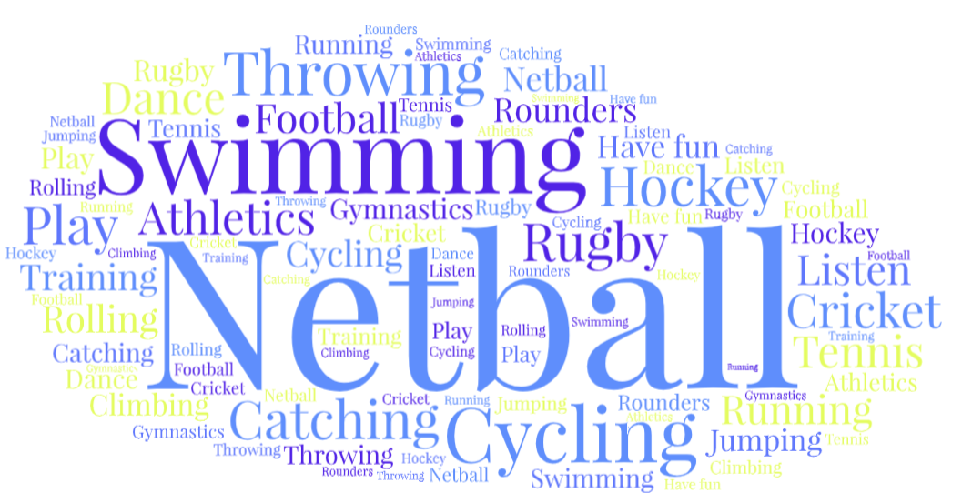
What do you do in your PE lesson?

Slide 7
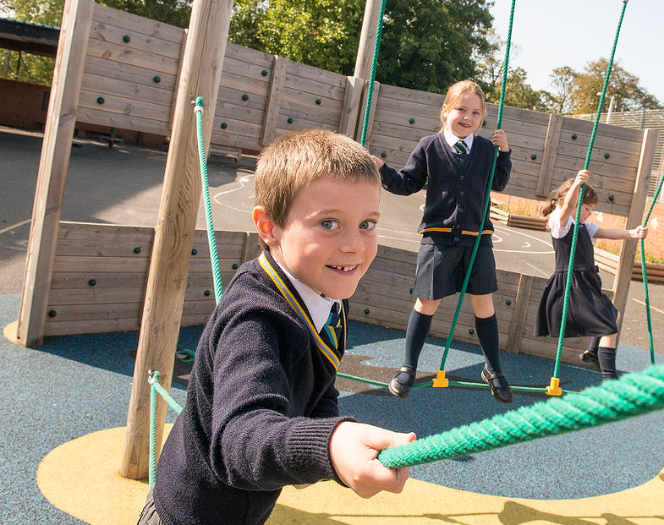
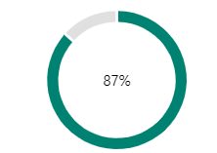
Do you attend an extra Curricular Club?
87% of children answered YES

Slide 8
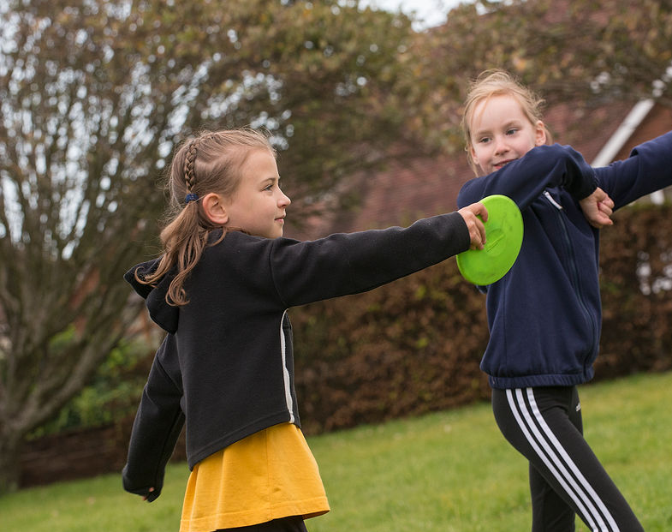
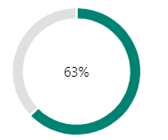
Have you represented school in an event or competition ?
63% of children answered YES

Slide 9
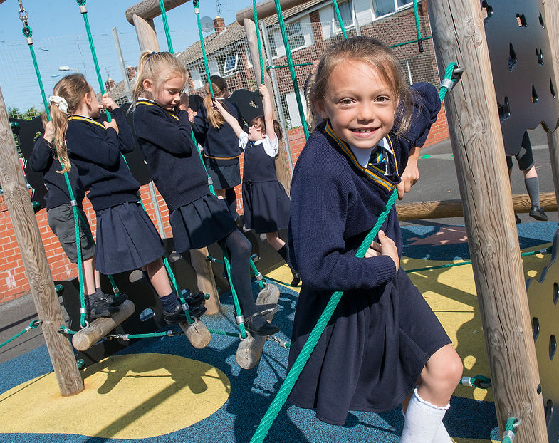
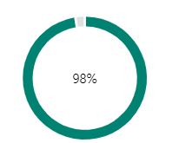
Do you look forward to your PE lesson?
98% of children answered YES

Slide 10
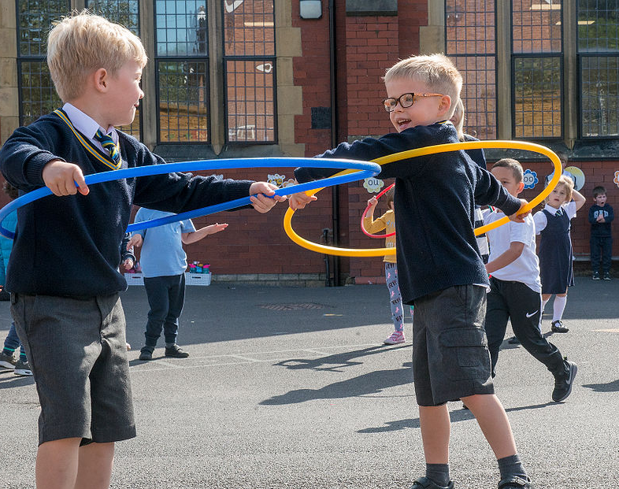
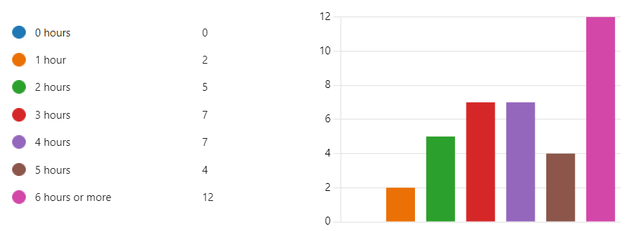
How long do you spend doing physical activity each week?

Slide 11
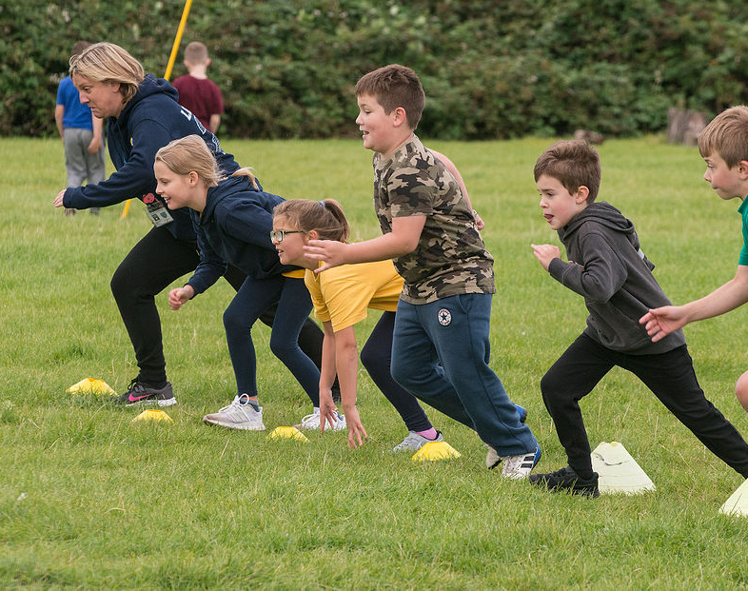
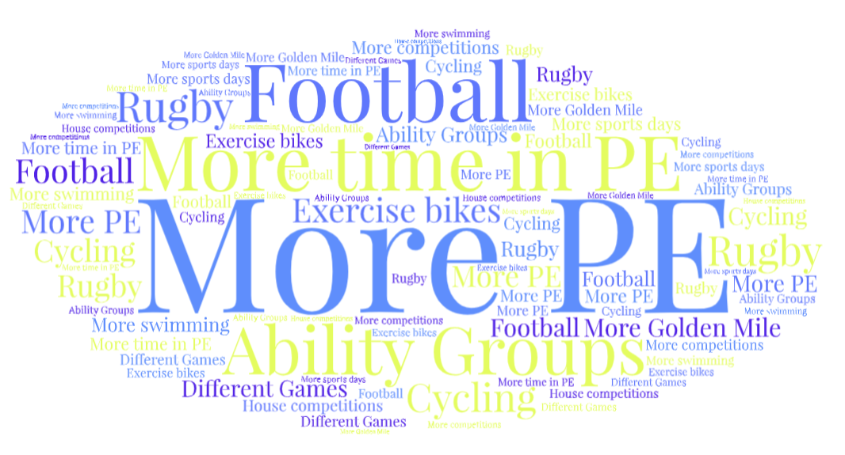
If you were in charge of PE, what would you change?

Slide 12
WE LOVE PE AT HEYHOUSES!

